Slide 1
Analysis of
Supply chain
DASHBOARD
GROUP MEMBERS
Sravanthi
Shobha
Ronak
Venkatesh
Rohith
Ajay kumar

Slide 2

1 | Introduction
2 | Objectives
3 | Tools & Methodology
4 | Limitations
5 | Summary
6 | Conclusion
Table of Contents

Slide 3
INTRODUCTION:
Supply chain dashboard designed to provide Real-Time visibility into Supply chain performance
Helps logistics managers, procurement teams, and executives monitor operations
Enables data-driven decisions to reduce costs and improve efficiency.

Slide 4
Objectives
Identify and analyze core supply chain KPI’s.
Track performance across Orders, Inventory, Procurement, Logistics & Demand.
Provide interactive dashboards with actionable insights.
Support forecasting and process optimation.

Slide 5
Tools Used
Excel → Data cleaning & initial dashboard creation.
SQL → Loading loan datasets into a structured database.
Power BI / Tableau → Data modeling, visualization, interactive dashboards.
Methodology:
Data cleaning , SQL Modeling, KPI Identification
Dashboard Development, QA & Validation

Slide 6
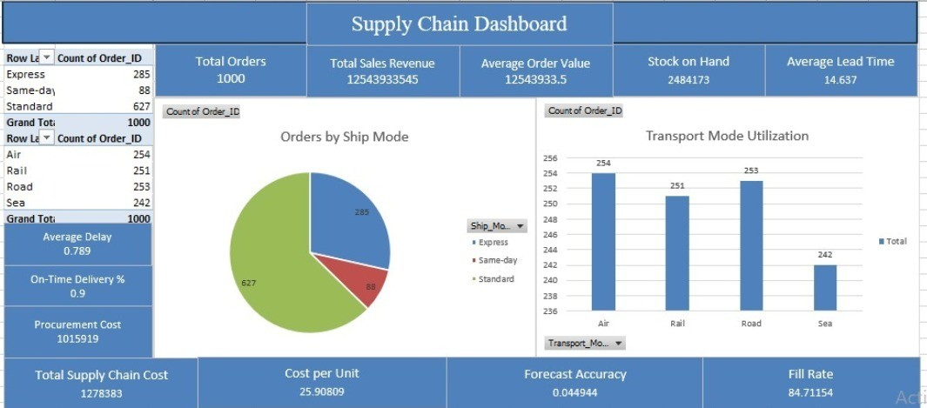
EXCEL DASHBOARD

Slide 7
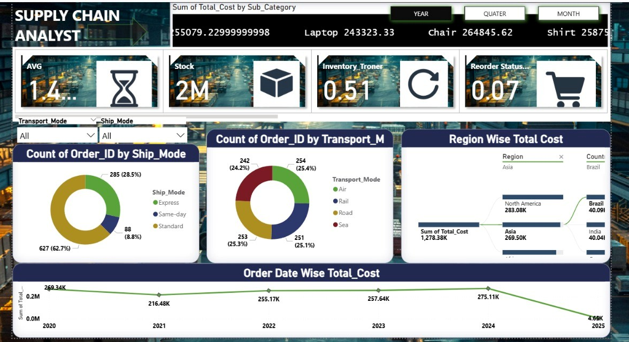
POWERBI DASHBOARD

Slide 8
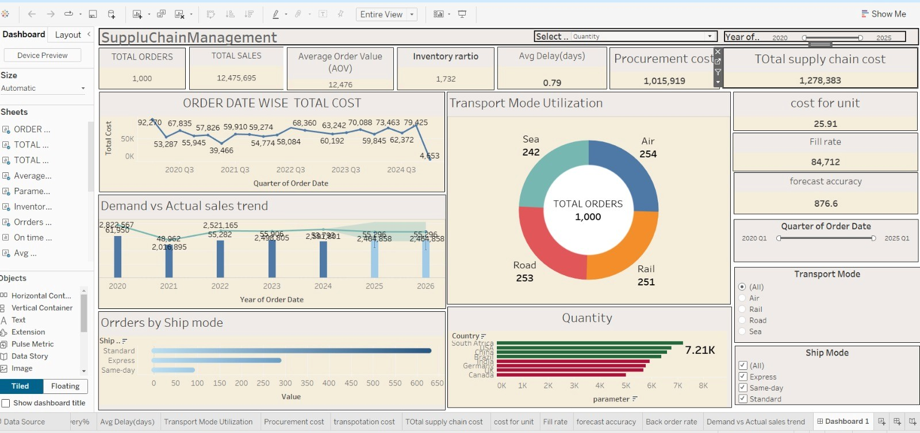
TABLEAU DASHBOARD

Slide 9
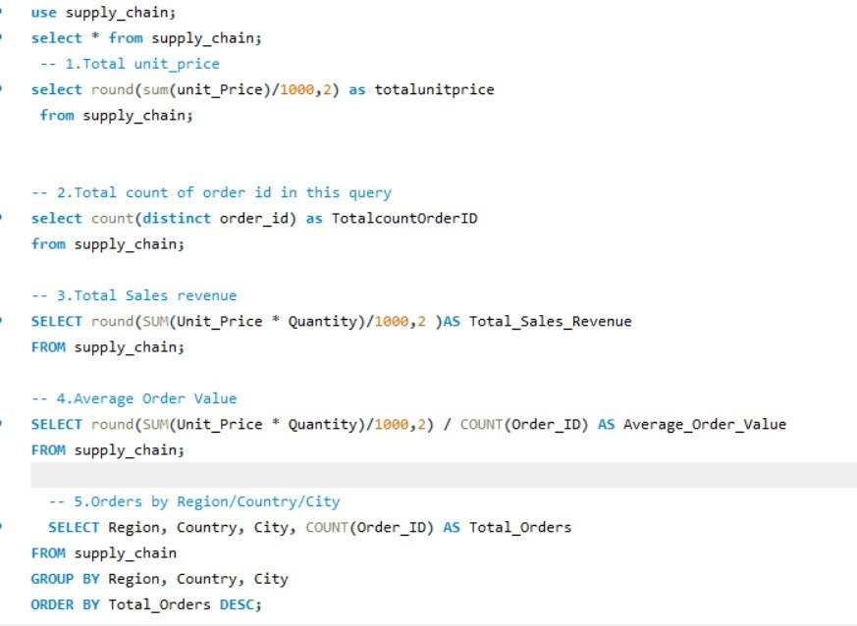
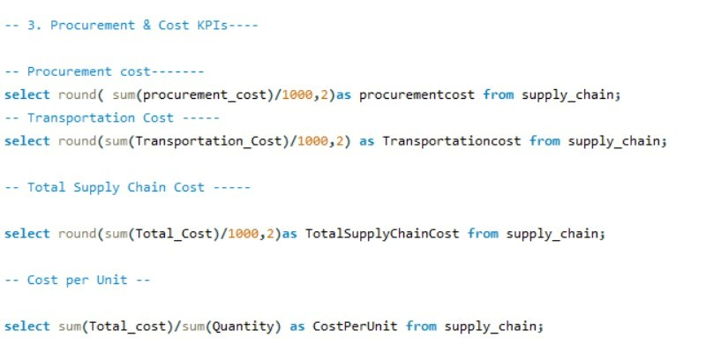
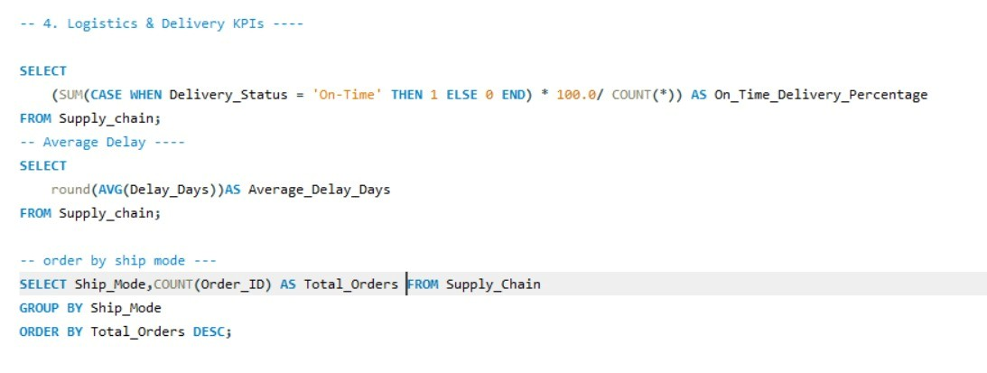
SQL SNAPSHOTS

Slide 10
LIMITATIONS
Data Dependency: Accuracy depends on Historical Data Quality..
Data Privacy: Does not capture quantitative supplier/ cutomer issues.
Time Lag: Dashboard may not reflect real-time data.
External Factors: Forecasts limited by external market fluctuations.

Slide 11
KEY FINDINGS
Orders and Revenue are growing, but Average order value changes a lot across regions.
Lead time is Higher in certain areas- delay in replineshment.
Transportation cost is higher compared to procurement cost.
On-Time Delivery rate is Low.
Many delays Happen in express shipping.
Forecasts don’t always match actual demand.

Slide 12
SUMMARY
Supply chain Dashboard provides end-to-end visibility.
KPI’s highlight orders,costs,logistics,demand fulfilment.
Interactive dashboards enable better forecasting & efficiency.
Supports bussiness decitions with data-backed insights.

Slide 13
Conclusion
Project demonstrated how tools transform raw supply chain data into insights.
Improved monitoring of orders fulfillment, costs, and delivery performance.

Slide 14
Inventory Dashboard

Slide 15
INDEX
Introduction
Objectives
Tools used for Data analysis and their limitations
Dashboard
Findings
Summary
Conclusion

Slide 16
Introduction
Definition of Supply Chain:-
  The supply chain is the network of organizations, people, activities, information, and resources involved in producing and delivering a product or service from suppliers to customers.
Definition of Inventory:-
  Inventory refers to the goods and materials a business holds for the purpose of resale, production, or utilization.
Role of Inventory in the Supply Chain:-
  Inventory connects production, warehousing, and distribution activities within the supply chain.
Importance of Inventory Management:-
  Ensures product availability and customer satisfaction.
  Reduces holding and carrying costs.
  Improves cash flow and overall operational efficiency.

Slide 17
Objectives
Maintain an optimal inventory level to meet demand without excessive stock.
Minimize wastage, obsolescence, and pilferage.
Facilitate smooth production and sales operations.

Slide 18
Tools Used
Excel → Dashboard creation.
SQL → Loading datasets into a structured database.
Power BI / Tableau → Data modeling, visualization, interactive dashboards.
Visualization Features Used:
Slicers (branch, state, product type).
Drill-down charts (branch → loan → customer).
KPIs with card visuals (Total Loan Amount, Default Rate).

Slide 19
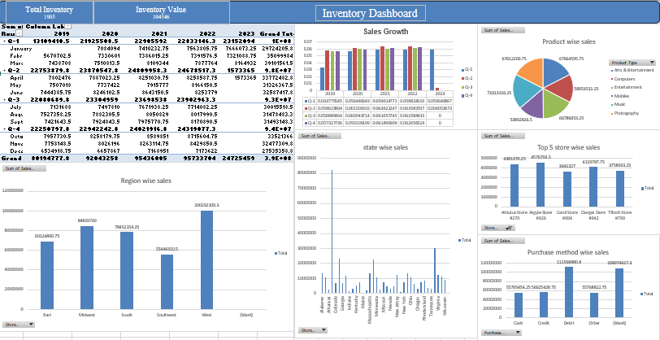
EXCEL DASHBOARD

Slide 20
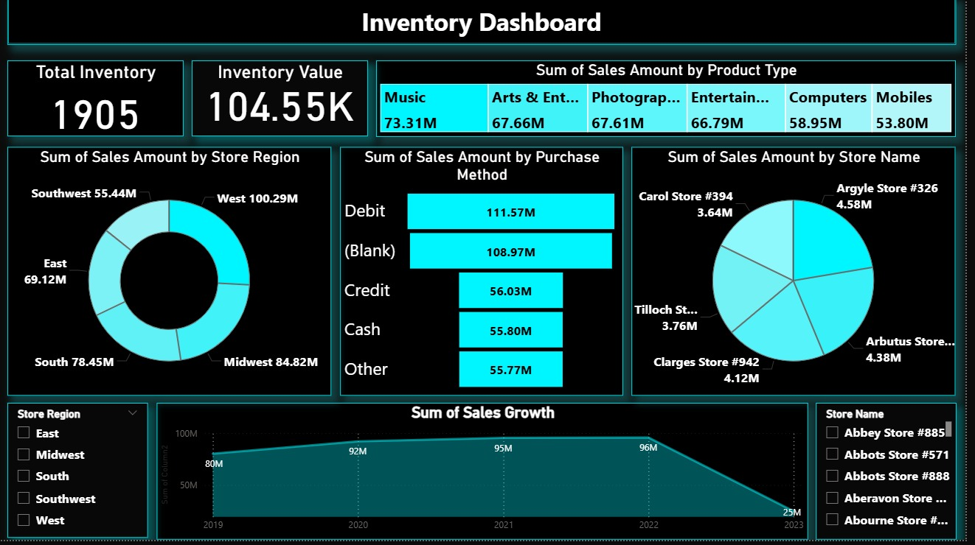
POWERBI DASHBOARD

Slide 21
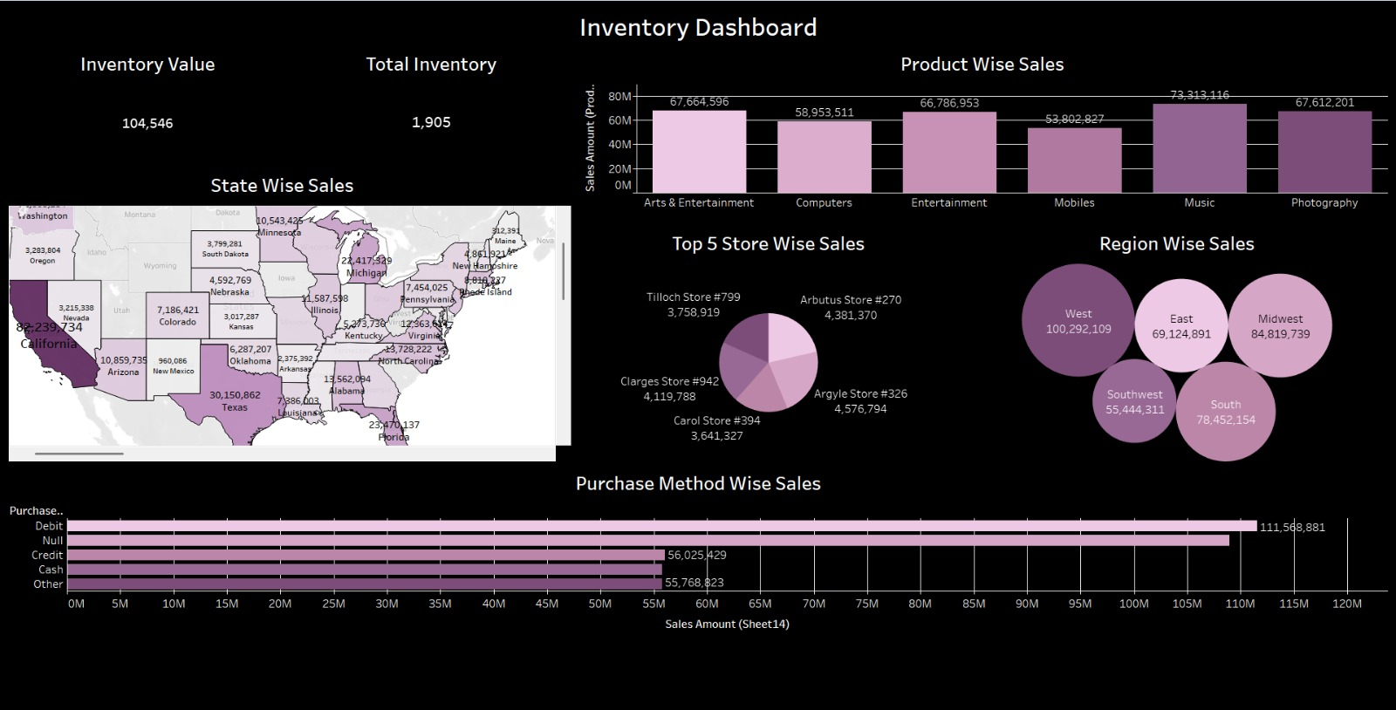
TABLEAU DASHBOARD

Slide 22
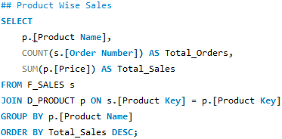
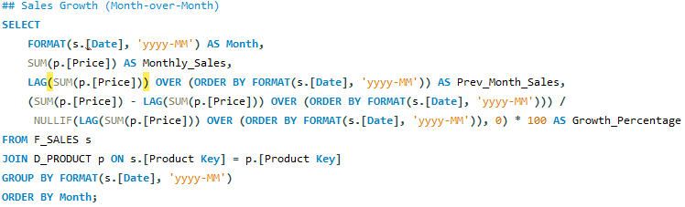

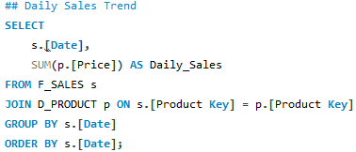
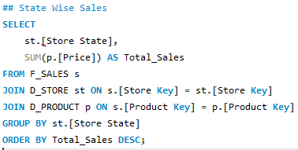

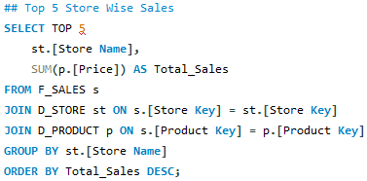
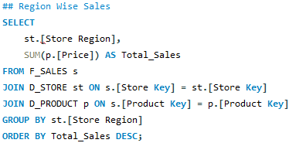
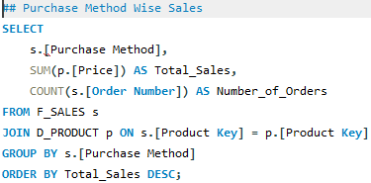
SQL SNAPSHOTS

Slide 23
Key Findings
Overall Insights:
  Sales are concentrated in the West region and California state.
  Debit card transactions are the most preferred payment method.
  Music and Entertainment products drive the majority of revenue.
  Few stores contribute significantly to overall sales, showing possible top-performer concentration.

Slide 24
LIMITATIONS
Data Dependency: Accuracy depends on quality of loan records.
Data Privacy: Customer-sensitive data must be secured.
Time Lag: Dashboard may not reflect real-time data.
Scope Limitations: Focuses on loans only (not overall banking).
External Factors: Doesn’t include macroeconomic risks (interest rate hikes, inflation).

Slide 25
SUMMARY
Inventory refers to the stock of raw materials, work-in-progress items, and finished goods held by a business to meet production and customer demand.
Effective inventory management helps reduce costs, avoid overstocking or stockouts, and improve overall efficiency in the supply chain.
Modern inventory practices like ERP systems enhance visibility, accuracy, and decision-making. In essence, well-managed inventory is essential for achieving a smooth, cost-effective, and responsive supply chain.

Slide 26
Conclusion
  Effective inventory management is a key component of supply chain efficiency, ensuring that products are available at the right place, in the right quantity, and at the right time.

Slide 27

Thank you

